Slide 1

Predictive Analysis of US Flight Delays
Brandon Boyle
20 Jan 2026

Slide 2
Overview
The Problem
Flight delays disrupts passenger travel and airlines operation cost
Objective
Use historical data to predict if a flight will be delayed
Proposed Solution
Use predictive modeling to estimate chances of delays
Based of multiple variables

Slide 3
Project Idea
Binary Outcome (Delayed or on-time)
Use variables like airline, route, day/time, etc.
Determine what factors lead to delays

Slide 4
The Dataset
Bureau of Transportation Statistics
U.S. Department of Transportation
December 2024
Over 600k rows
10 variables

Slide 5
Predictive Models
Random Forest Model
Combination of many decision trees
Gradient Boosting
Trees are weighted and made sequentially
Support Vector Machine
Handles marginal relations or finds
Notes:
Random Forest
- Works well with mixed data
Gradient Boosting
- builds tress one after another, correcting mistakes made
- High accuracy
- able to capture small interactions between multiple variables

Slide 6
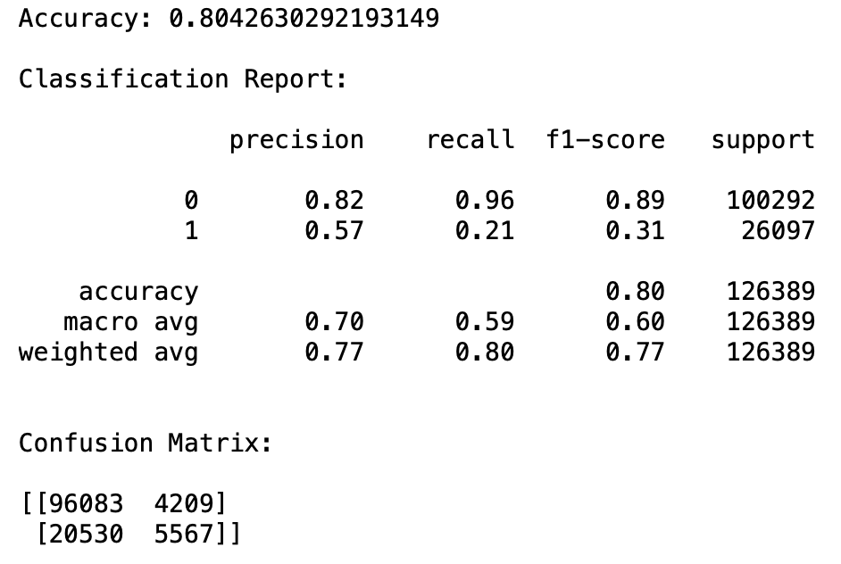
Random Forest

Slide 7
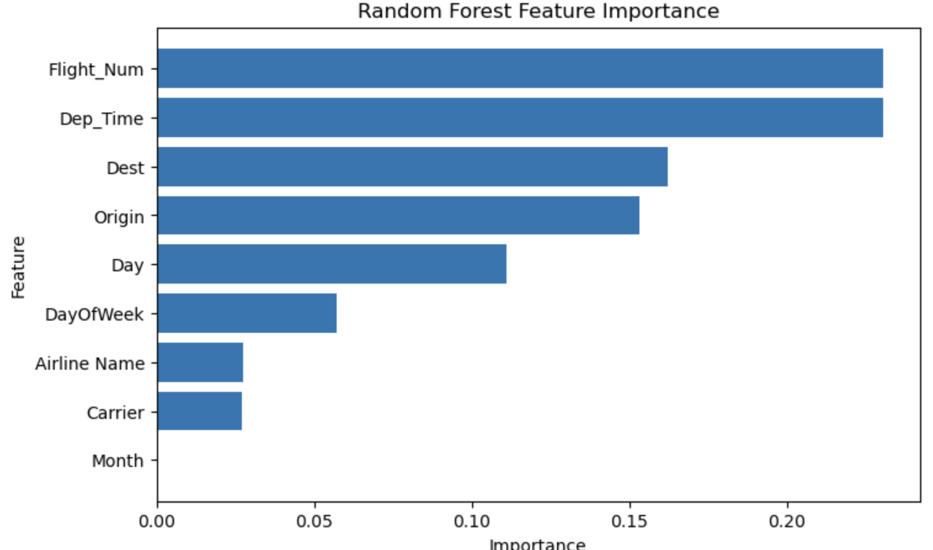
Key Findings

Slide 8
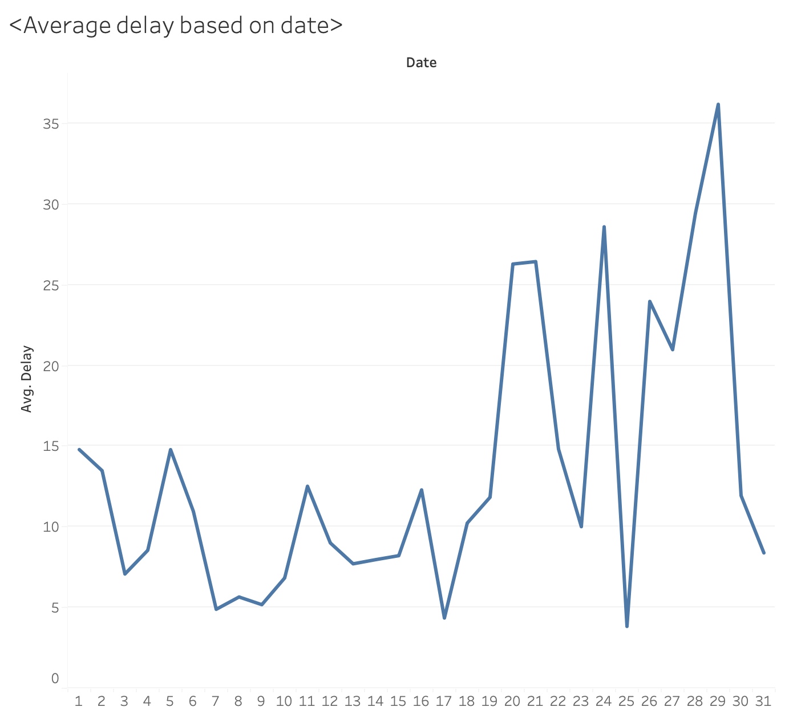
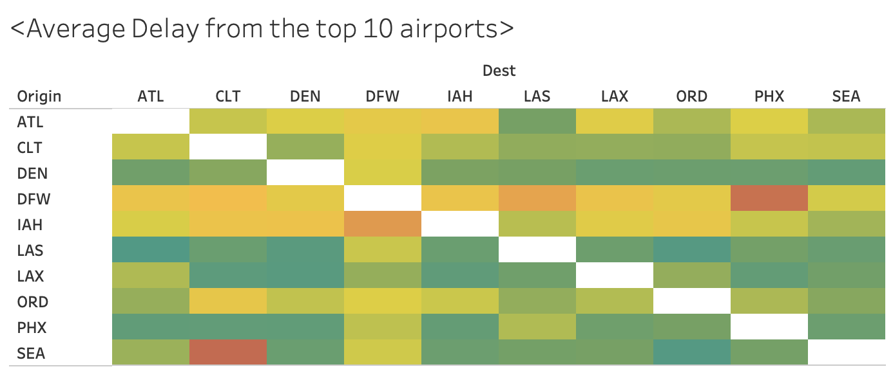
Cont.

Slide 9
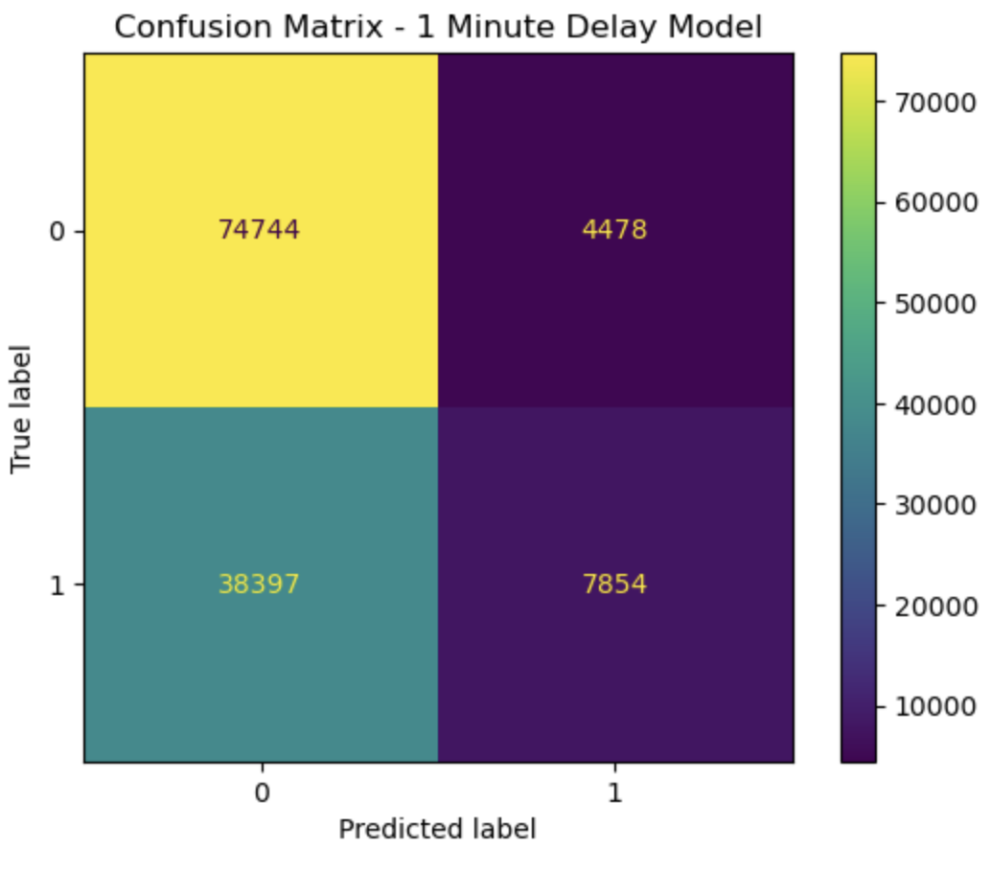
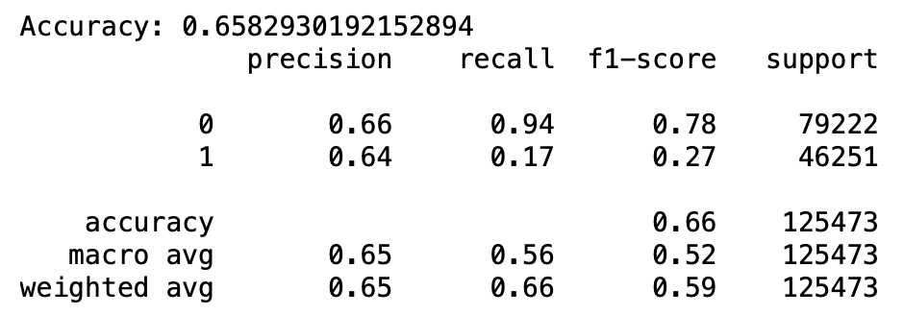
Gradient Boosting – 1 minute

Slide 10
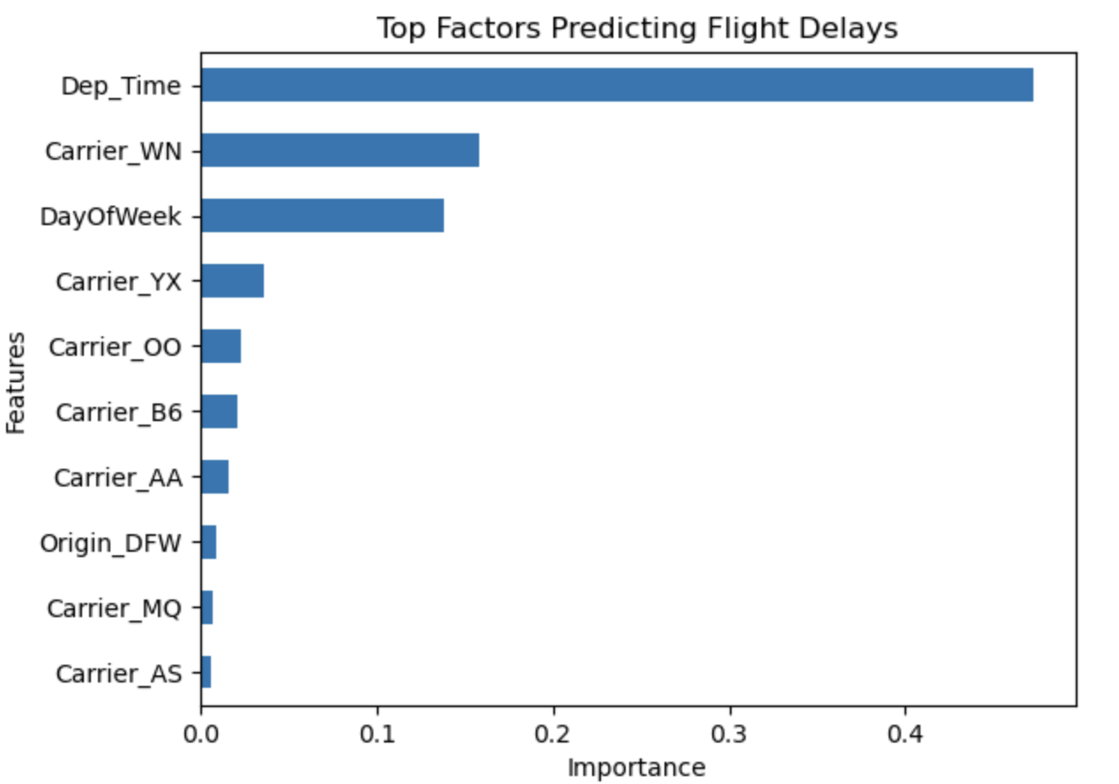
Key Findings

Slide 11
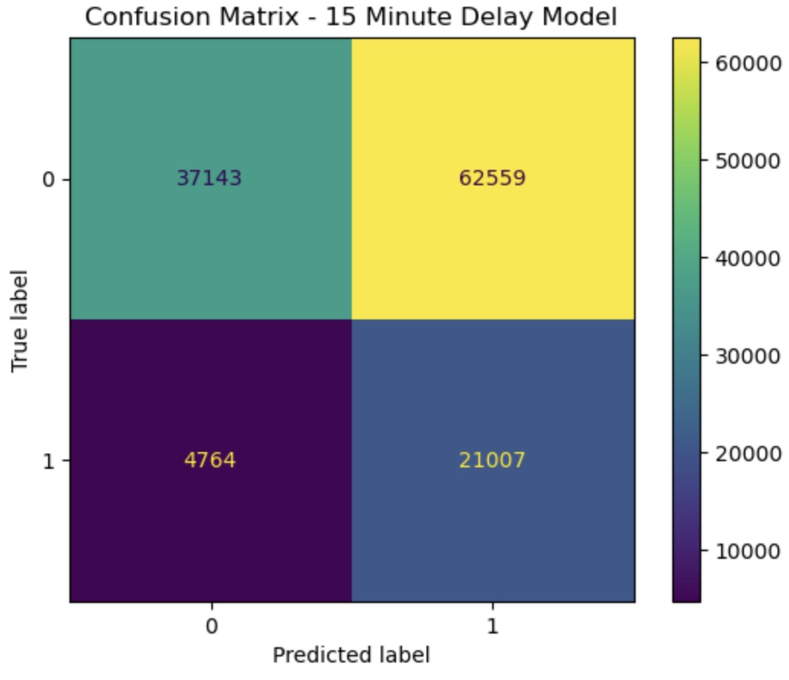
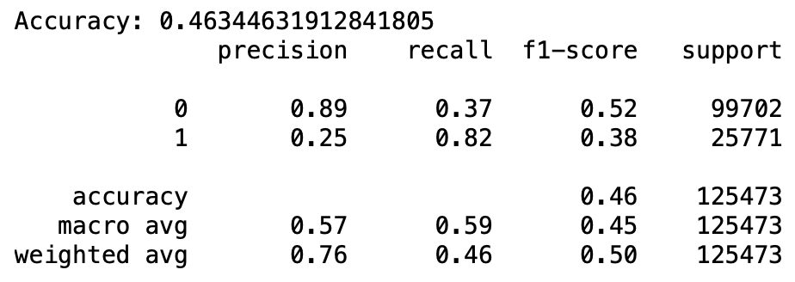
Gradient Boosting – 15 Minutes

Slide 12
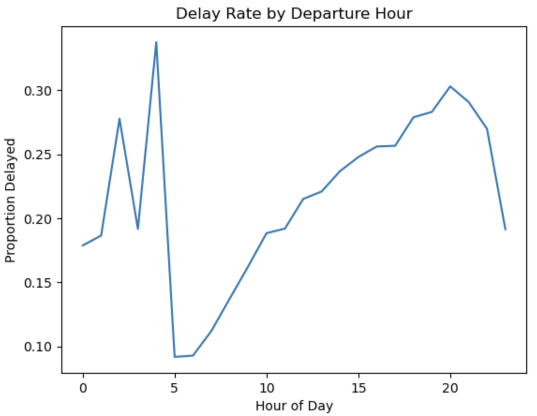
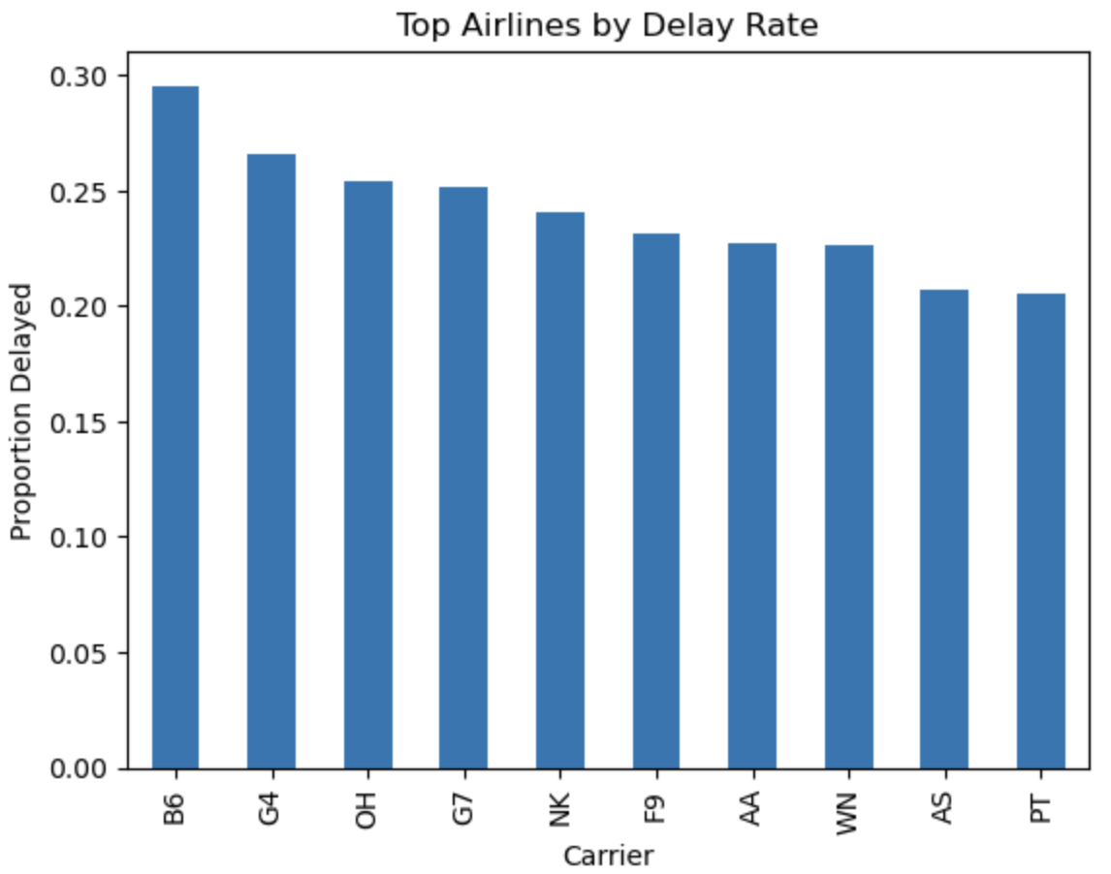
Key Findings

Slide 13
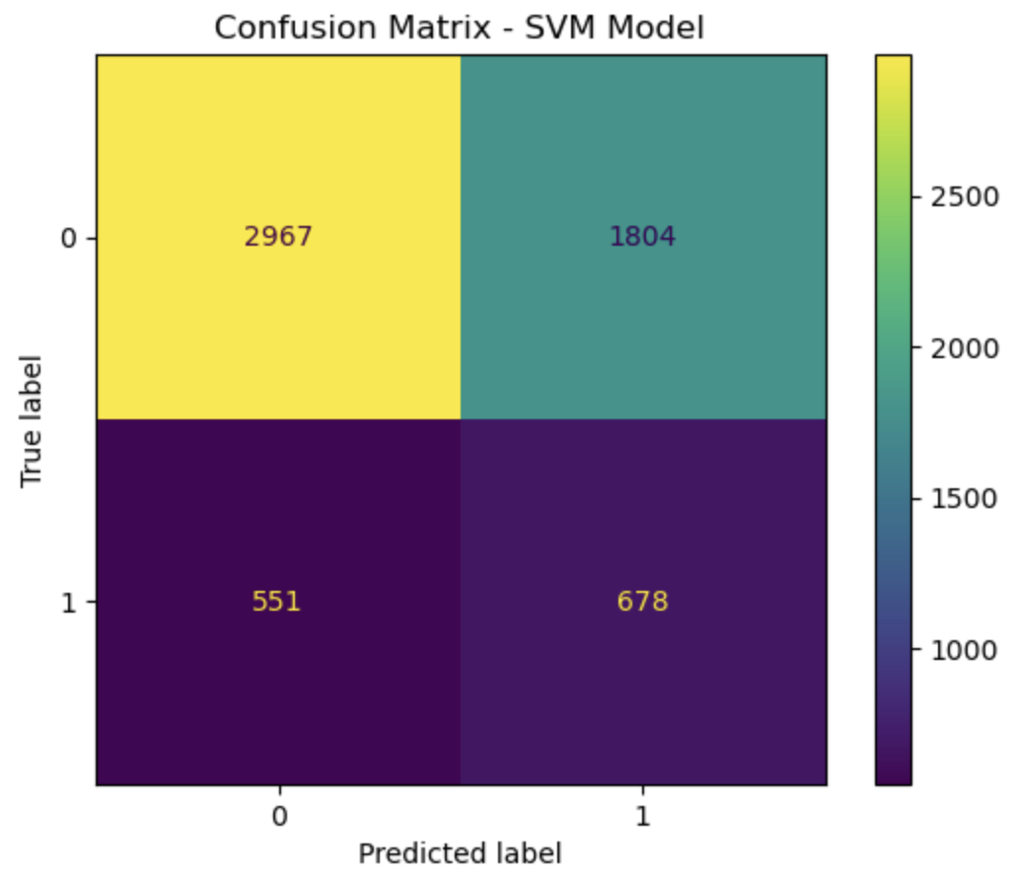
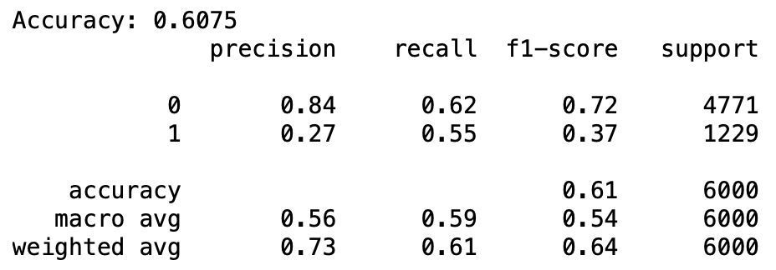
Support Vector Machine

Slide 14
Conclusion
Main Influences: Departure time, airline, scheduling pattern
Delays increase throughout the day
Definition of delay changes a lot
Random Forest was most accurate but missed most delays
Gradient Boosting 15min caught the most delays
SVM was the most balanced
Real word detecting delays is the most important

